Slide 1
Software Design Patterns
- The Agile Unified Methodology

Slide 2
Why the Agile Unified Methodology
Review of agile unified process
  because there are several versions
  because many people don't design OO systems properly
  because we need a unified process for the project for this class
The agile unified methodology provides a framework for applying patterns.
  see pattern application process
Copyright © The McGraw-Hill Companies, Inc.

Slide 3
The Unified Process
Requirements
Requirements
Design
Design
Code
Code
Test
Test
Deploy
Deploy
Time
time
time
TIME
The waterfall process
Iteration 1
Iter. 2
Iter. 3
Iter. 4
The unified process
Copyright © The McGraw-Hill Companies, Inc.

Slide 4
Overview of Methodology
behavior modeling include sequence diagrams, state diagrams, and activity diagrams.
Analysis activities
Business goals
& needs
Current situation
Use case-iteration allocation matrix
Accommodating
Requirements Change
Customer
feedback
Analysis activities
Acquiring
Requirements
Domain
Modeling
Iteration use cases
Domain Modeling
Preliminary requirements
Domain model
Domain model
Deriving Use Cases
from Requirements
Actor-System Interaction Modeling
Design activities
Abstract & high level use cases, use case diagrams
Expanded use cases & UI design
Allocating Use Cases & Subsystems
to Iterations
Behavior Modeling &
Responsibility Assignment
Behavior models
Use case-iteration allocation matrix
Deriving Design Class
Diagram
Design activity
Producing an Architecture Design
Design class diagram
Software architecture
Test Driven Development, Integration, & Deployment
(a) Planning Phase
(b) Iterative Phase – activities during each iteration
control flow
data flow
control flow & data flow
Copyright © The McGraw-Hill Companies, Inc.

Slide 5
The Unified Process
Use case driven
  each iteration is driven by the use cases allocated to the iteration
Architecture centric
  “a system's architecture is used as a primary artifact for conceptualizing, constructing, managing, and evolving the system under development." --- Grady Booch
Incremental
Iterative
Copyright © The McGraw-Hill Companies, Inc.

Slide 6
Domain Modeling
What:
  A process that helps the team understand the application or application domain.
  It enables the team to establish a common understanding.
Why:
  Software engineers need to work in different domains or different projects. They need domain knowledge to develop the system.
  Software engineers come from different backgrounds, which affect their perception of the application domain.
When: requirements and beginning of each iteration.
How:
  Collect domain information, perform brainstorming and classification, and visualize the domain knowledge using a UML class diagram
Copyright © The McGraw-Hill Companies, Inc.

Slide 7

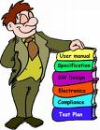


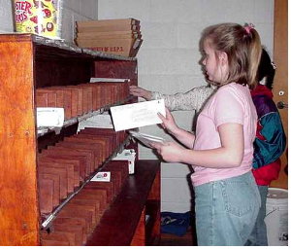
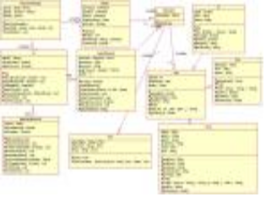
Domain Modeling Steps
2. Brainstorming
1. Collecting application domain information
4. Visualization
3. Classification
Copyright © The McGraw-Hill Companies, Inc.

Slide 8
Steps for Domain Modeling
1) Collecting application domain information
  base on a business description
  focus on the functional requirements
  also consider other requirements and documents
2) Brainstorming
  identify important domain concepts and phrases
(to be continued)
Copyright © The McGraw-Hill Companies, Inc.

Slide 9
Steps for Domain Modeling
3) Classifying the domain concepts and phrases into:
  classes
  attributes / attribute values
  relationships
    association, inheritance, aggregation
4) Visualizing the classification results using a UML class diagram
Copyright © The McGraw-Hill Companies, Inc.

Slide 10
Step 1. Collecting Domain Information
Using information collection techniques.
Producing a business description from the information collected.
Copyright © The McGraw-Hill Companies, Inc.

Slide 11
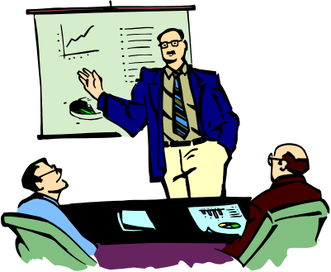
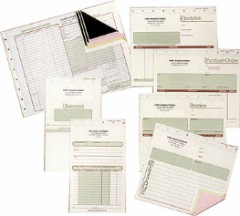






Information Collection Techniques
business
forms
operating
procedures
regulations &
standards
Customer presentation
Literature survey
Writing user stories
Stakeholder survey
User interviews
Copyright © The McGraw-Hill Companies, Inc.

Slide 12
Sample Business Description
A car rental company operates a number of rental locations throughout the metropolitan area. Since the company has a great business model and provides customer-friendly service, its business has bloomed over the last several years. As the business has grown rapidly, the costs of manually running its business has also increased. In particular, as the job market becomes hot, the labor cost has doubled. The company wants to ﬁnd a solution to reduce its operating cost. The business operation of the company is described as follows. The description is not meant to be complete, and the company is ﬂexible enough to consider any good improvement proposals.
Vehicles can be taken from one location and returned to the same location or to a diﬀerent location with an additional charge. Although the company is, at present, concerned only with passenger cars, it may branch out into other forms of vehicle rentals in the future and would like to be able to use the same reservation system. The company has several diﬀerent makes of cars in its rental ﬂeet, from diﬀerent manufacturers. Each make may have several
models.
For example, Toyota has Corolla, Camry, and more. The models are grouped into a small number of price classes. The customer must be able to select the make and the model he or she wants to rent. If the selected car is not available, the system should display a message telling the customer that the car is rented out and let the customer select another make and model, or have the system suggest similar models of a diﬀerent make.
The company has a number of rental plans available to customers. For example, there is a daily-unlimited-miles plan and a weekend-discount plan. The company ﬁnds it important to have information available on the models of car, such as automatic or manual gear change, two or four doors, and sedan or hatchback. The rental prices may be diﬀerent for diﬀerent options and a customer will want to know such information when reserving a car. Currently, customers make reservations directly with the car rental company either in person or via phone call. The salespersons process the reservations manually using a reservation form and archive
Copyright © The McGraw-Hill Companies, Inc.

Slide 13
Sample Business Description (continued)
them in the ﬁle cabinet. No deposit is required at the time of reservation. The reservation is voided if the customer does not show up to sign the contract for more than a given period of time.
Such reservation is honored only if there are still cars available to satisfy the request. When a rental car(s) is checked out to a customer, the salesperson has to ensure that the driver(s) has a valid driver license. The salesperson must also ensure that the driver(s) has up-to-date state-required liability insurance. If the driver(s) does not have such insurance, then he is required to purchase the insurance from the car rental company.
A car may or may not be available for rental on a given day. Rental cars need frequent preventive maintenance and, in addition, any damage to a car has to be repaired as soon as possible. The rental cars must be inspected annually to ensure that they are in good working condition and satisfy EPA’s emission requirements. The company wants to keep track of the rental car purchase, repair, maintenance, and disposal
information for business and tax purposes.
Sometimes a customer wishes to make a block reservation for several cars and to have the invoices for all rentals on the reservation handled together. As soon as a car is checked out to a customer, an invoice is opened. A single invoice may cover one or more rentals. Normally a customer will settle the invoice when the car is returned but, in some cases, the invoice must be sent to a company (such as the customers employer). When the customer pays by a credit card, the rental charge will be processed through a credit card processing company.
Copyright © The McGraw-Hill Companies, Inc.

Slide 14
Step 2. Brainstorming
The team members get together and identify & list domain specific, domain specific, domain specific
  nouns / noun phrases
  "X of Y" expressions (e.g., color of car)
  transitive verbs
  adjectives, enumeration
  numeric, quantity
  possession expressions (has/have, possess, etc.)
  “consist of / part of" expressions
  containment / containing expressions
  "X is a Y" expressions (generalization/specialization)
X, Y are nouns/noun phrases
Copyright © The McGraw-Hill Companies, Inc.

Slide 15

adjective, but not
domain specific
domain specific
transitive verb
Example
The web-based application must provide a search capability for overseas exchange programs using a variety of search criteria.
transitive verbs, but not domain specific
nouns but
not domain
specific
domain specific
noun/noun phrases
Brainstorming result:
  nouns/noun phrases
  programs
  search criteria
  transitive verbs
  search for
Copyright © The McGraw-Hill Companies, Inc.

Slide 16
Step 3. Classifying Brainstorming Result
The domain-specific phrases identified during brainstorming step are classified as
  classes
  attributes of classes, and
  relationships between classes
    inheritance relationships
    aggregation relationships
    association relationships
Copyright © The McGraw-Hill Companies, Inc.

Slide 17
Class and Attribute? How to Classify
A noun/noun phrase can be a class or an attribute, how do we distinguish?
This is often a challenge for beginners.
Rules to apply:
An object has an "independent existence" in the
application/application domain, an attribute does not.
Example: "Number of seats", class or attribute?
Attribute, because "number of seats" cannot exist without
referring to a car, airplane, or classroom as in
"number of seats of a car"
"number of seats of a classroom"
Copyright © The McGraw-Hill Companies, Inc.

Slide 18
Class or Attribute? More Rules to Apply
Rules to apply:
  Attributes describe objects or store state information of objects.
  Attributes are of scalar types such as int, double, string, char and boolean; classes are not.
  You can enter attribute values from the keyboard, but you cannot do so for objects.
  Objects must are created by invoking a constructor.
  The rules presented in these two slides are used to classify the domain concepts in the next slide!
Copyright © The McGraw-Hill Companies, Inc.

Slide 19
Classifying Brainstorming Result
Noun/noun phrase
"X of Y" expression
Transitive verb
Adjective, enumeration
Numeric, quantity
Possession expressions (has/have, possess, etc.)
“Consist of/part of" expression
Containment / containing expression
"X is a Y" expression
class or attribute
X is an attribute of Y
X is part of Y
X is a role in an association
association relationship
attribute value
attribute value / multiplicity value
aggregation, association or attribute
aggregation relationship
association or aggregation
inheritance
Remember:
Objects have independent existence, attributes do not.
Attributes are scalar types, classes are not.
Copyright © The McGraw-Hill Companies, Inc.

Slide 20
Inheritance Relationship
It expresses the generalization/specialization relations between concepts.
One concept is more general/specialized than the other.
Example: vehicle is a generalization of car, car is a specialization of vehicle.
It is also called IS-A relation.
Vehicle
model#
horse power
manufacturer
start()
Car
drive()
Boat
sail()
UML class diagram
Copyright © The McGraw-Hill Companies, Inc.

Slide 21
Two Tests for Inheritance
IS-A test: every instance of a subclass is also an instance of the superclass.
Conformance test: relationships of a superclass are also relationships of subclasses.
Engine
model#
horse power
manufacturer
start()
stop()
Professor
name
phone
teach(...)
Retirement Plan
enroll
Car is not an engine.
Visiting Professor
signContract()
Car
drive()
Visiting professors cannot enroll in a retirement plan at the host university.
Copyright © The McGraw-Hill Companies, Inc.

Slide 22
Aggregation Relationship
It expresses the fact that one object is part of another object.
Example: engine is part of a car.
It is also called part-of relationship.
Car
model#
horse power
manufacturer
start()
stop()
part-of relationship
Engine
model#
horse power
manufacturer
start()
stop()
Copyright © The McGraw-Hill Companies, Inc.

Slide 23
Association Relationship
It expresses a general relationship other than inheritance and aggregation.
It is an application-specific relationship between two concepts.
Example: “faculty teach course,” “user has account.”
Often derived from a domain-specific transitive verb.
Professor
name
phone
teach(...)
Retirement Plan
enroll
Enroll is not an inheritance or aggregation relationship.
Copyright © The McGraw-Hill Companies, Inc.

Slide 24
Step 3. Classification: Examples
Domain specific
nouns/noun phrases
transitive verbs
  program
  search criteria
  user
  search for (programs)
(c)
(c)
(c)
search for
Rule: transitive verbs ⇒
association relationships
Rule: noun/noun phrase ⇒
class or attribute
Because they exist
independently in the application domain.
Copyright © The McGraw-Hill Companies, Inc.

Slide 25
Classification: Example
noun/noun phrases
numeric
A car has make, model, horse power, number of seats ...
possession expression
(c) car
(a) make
(a) model
(a) horse power
(a) number of seats
Car has independent existence.
Make, model, horse power, and
number of seats do not; they are scalar types.
A customer can rent one or more cars.
(c) customer
(c) car
rent
1+
Copyright © The McGraw-Hill Companies, Inc.

Slide 26
Class Exercise
Do the following for your team project or the vending machine (next slide).
Identify the concepts that exist in the application domain.
Classify the concepts in terms of
  classes
  attributes of classes
  relationships between the classes
    inheritance
    aggregation and
    association
Copyright © The McGraw-Hill Companies, Inc.

Slide 27
Class Exercise: The Vending Machine
The Vending Machine has a display, an alphanumeric keypad, a coin insertion slot, and an item dispenser. The display shows the vending items like chocolates, candies, potato chips, coke, sprite, etc. Each type of item has a price and a label consisting of a letter A, B, C, ... and a digit 1, 2, ... A customer inserts coins through the coin slot. Each time a coin is inserted an LCD displays the total amount. The customer can press a letter and a digit to enter his selection after enough coins have been inserted. If the total amount is greater than or equals to the item selected, the vending machine dispenses the item and returns the change to the customer. A customer can change his mind and request that the coins be returned by pressing the return button.
Copyright © The McGraw-Hill Companies, Inc.

Slide 28
Association Class
An association class defines properties and operations for an association between two classes.
Students enroll in courses
and receive grades.
Student
*
enroll
*
Course
Enroll
indicate Enroll
class is a class
for the association
grade: char
getGrade()
setGrade(grade:char)
Copyright © The McGraw-Hill Companies, Inc.

Slide 29
Understand Association Class
Alex got an “A” and Eric got a “B” for OOSE.
object
identifier
type
Alex:Student
enroll
OOSE:Course
enroll
Eric: Student
:Enroll
:Enroll
‘A’: char
‘B’: char
getGrade()
setGrade()
getGrade()
setGrade()
enroll
AI:Course
Alex also got an
“A” for AI.
:Enroll
‘A’: char
This is an object diagram.
getGrade()
setGrade()
Copyright © The McGraw-Hill Companies, Inc.

Slide 30
Understand Association Class
Implementation
Student
enroll
Course
class Student { ... }
class Course {...}
class Enroll {
private char grade;
private Student student;
private Course course;
public Enroll (Student s, Course c) {
student=s; course=c;
}
public char getGrade() {…}
public void setGrade(char grade) {…}
}
Enroll
grade: char
getGrade()
setGrade(grade:char)
Student alex=new Student( ... );
Course oose=new Course ( ... );
...
// at begin of semester
Enroll e=new Enroll(alex, oose);
// at end of semester
e.setGrade(‘A’);
Copyright © The McGraw-Hill Companies, Inc.

Slide 31
Understand Association Class
Student
Student
enroll
Course
sid
name
phone
...
...
001
Alex
...
...
...
002
Eric
...
...
...
Enroll
grade: char
getGrade()
setGrade(grade:char)
Course
cn
title
desc
...
...
c1
oose
...
...
...
c2
AI
...
...
...
OO Realm
Enroll
sid
cn
grade
...
...
001
c1
A
...
...
001
c2
A
...
...
002
c1
B
...
...
RDB Realm
Copyright © The McGraw-Hill Companies, Inc.

Slide 32




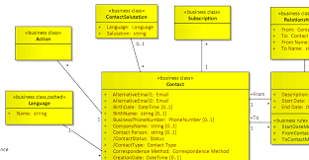
Tip for Domain Modeling
Do not draw the class diagram during brainstorming and classification. The result could be very poor!
1) List the concepts, and then classify them on a whiteboard.
2) Take a picture(s) of the whiteboard using a digital camera.
3) Email the digital images to team members.
5) Email the UML class diagram to all members to review.
6) Modify the diagram to reflect corrections and comments.
4) Have a member or two to convert the result to a UML class diagram.
Copyright © The McGraw-Hill Companies, Inc.

Slide 33
Deriving Use Cases from Requirements
What is a use case?
A use case is a business process. (This is the key.)
A use case must be initiated by an actor.
A use case must end with the actor.
  The actor explicitly or implicitly acknowledges the accomplishment of the business task.
A use case must accomplish a business task (for the actor).
Copyright © The McGraw-Hill Companies, Inc.

Slide 34
What Is an Actor
An actor denotes a business role played by (and on behalf of) a set of business entities or stakeholders.
Actors are not part of the system.
Actors interact with the system.
Actors are often human beings but can also be a piece of hardware, another system, or another component.
Actors initiate use cases, which accomplish business tasks for the respective actors.
Copyright © The McGraw-Hill Companies, Inc.

Slide 35
Business Process, Step, Operation and Action
A business process is a series of steps to accomplish a complete business task.
An operation is a series of actions or instructions to accomplish a step of a business process.
Copyright © The McGraw-Hill Companies, Inc.

Slide 36
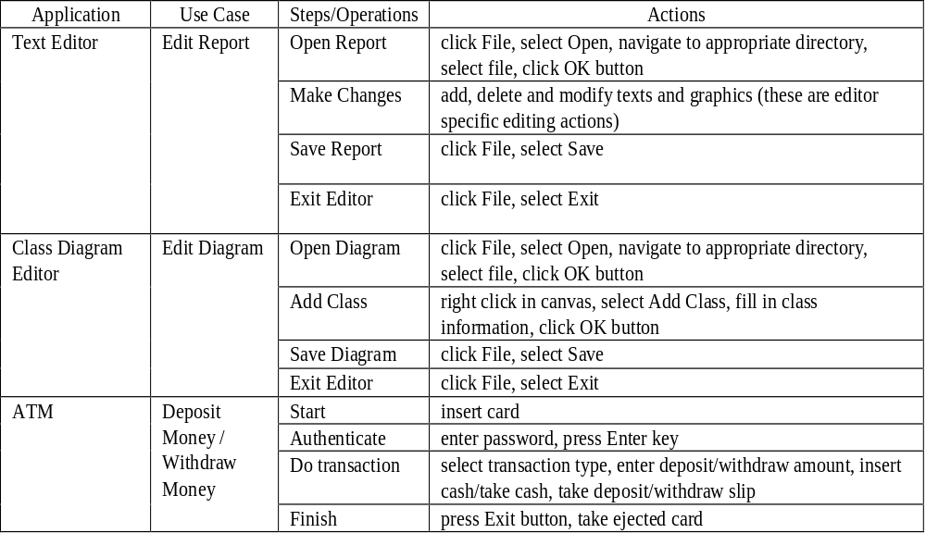
Business Process, Step, Operation and Action
Copyright © The McGraw-Hill Companies, Inc.

Slide 37

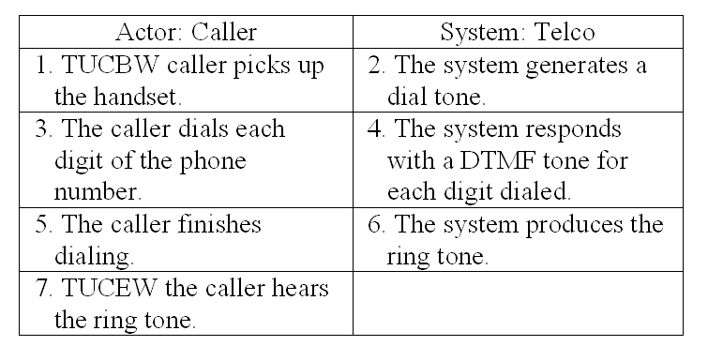
Use Case Modeling Steps
planning phase
iterative phase
Deriving use cases
from requirements
requirements
abstract use cases
(e.g., Initiate a Call)
Defining use case scope
abstract &
High-level use cases
Example high level use case:
TUCBW caller picks handset from base
TUCEW caller hears the ring tone.
Telco
Initiate a Call
Answer a Call
Specifying actor-
system interaction
(expanded use cases)
Depicting use case contexts
Copyright © The McGraw-Hill Companies, Inc.

Slide 38
Deriving Use Cases from Requirements
In the requirements specification, look for verb-noun phrases that indicate domain specific, domain specific, domain specific
  “do something”
  “something must be done” or
  “perform some task”
  in the application domain.
Verify the verb-noun phrases using use case definition (next slide).
Copyright © The McGraw-Hill Companies, Inc.

Slide 39
Verify the Use Cases Identified
Verify the use cases identified using use case definition:
  (1) Is it a business process? y/n
  (2) Is it initiated by an actor? y/n
  (3) Does it end with the actor? y/n
  (4) Does it accomplish a business task for the actor? y/n
  All the answers to above questions must be “y.”
Copyright © The McGraw-Hill Companies, Inc.

Slide 40
Identify Actor, System or Subsystem
3. From the requirements, identify also
  the actors, who initiate the tasks, or for whom the tasks are performed
  the system or subsystem that contains the use case
Copyright © The McGraw-Hill Companies, Inc.

Slide 41
Example: Library System
Requirements of a library system:
R1. The library system must allow a patron to
check out documents.
R2. The library system must allow a patron to
return documents.
system
actor
use case
 | Verb-Noun Phrase | Business Process? | Begin w/ Actor? | End w/ Actor? | Useful Task for Actor? | Use Case? | Actor | System
R1
Checkout Document
Y
Y
Y
Y
Y
Patron
Library System
R2
Return Document
Y
Y
Y
Y
Y
Patron
Library System
Copyright © The McGraw-Hill Companies, Inc.

Slide 42
Use Case Diagram: Library Example
system/subsystem
use case
actor
Library/Circulation
Checkout Document
Return Document
Patron
Search for Document
association
system boundary
Copyright © The McGraw-Hill Companies, Inc.

Slide 43
Example: Oversea Exchange Program
R1. The web-based application must provide a search capability for overseas exchange programs using a variety of search criteria.
R2. The web site must provide a hierarchical display of the search results to facilitate user navigation from a high level summary to details about an overseas exchange program.
Use Case
Business Process?
Begin w/ Actor?
End w/ Actor?
Useful Task for Actor?
Use Case?
Actor
System
R1
Search for Programs
Y
Y
Y
Y
Y
User
Web App.
R2
Display Program Details
Y
Y
Y
Y
Y
User
Web App.
Copyright © The McGraw-Hill Companies, Inc.

Slide 44
Are the followings use cases? Why?
Check authorization / check authentication
Enter a password
Process data
Open a file
Click on a menu item
Traverse a linked list.
Start a system
Copyright © The McGraw-Hill Companies, Inc.

Slide 45
Use Case Specification: 3 Levels of Abstraction
Abstract use case: a verb-noun phrase
High-level use case: when and where the use case begins and when it ends
  TUCBW (This use case begins with ...)
  TUCEW (This use case ends with ...)
Expanded use case: step-by-step description of how the actor interacts with the system to carry out the business process
Copyright © The McGraw-Hill Companies, Inc.

Slide 46
Abstract Use Case and High level Use Case
Abstract use case: Initiate a Call
High-level use case:
    Use Case: Initiate a Call
    TUCBW the caller picks up the handset from the phone base.
    TUCEW the caller hears the ring tone.
Copyright © The McGraw-Hill Companies, Inc.

Slide 47
High Level Use Case Example
Use Case: Withdraw Money (from an ATM)
TUCBW the ATM user inserts an ATM card into the card slot.
TUCEW the ATM user receives the correct amount of cash and a withdraw slip.
Use Case: Search for Programs
TUCBW a SAMS user clicks the ``Search for Programs'' link on any of the SAMS pages.
TUCEW the user sees a list of programs satisfying the search criteria.
Copyright © The McGraw-Hill Companies, Inc.

Slide 48
Guidelines for High-Level Use Case
A high-level use case should not specify background processing:
  Do not specify how the system process the request such as update the database.
  Background processing is modeled by sequence diagrams.
High-level use cases should end with what the actor wants to accomplish.
Copyright © The McGraw-Hill Companies, Inc.

Slide 49
Requirements/Use Case Tractability Matrix
PriorityWeight
UC1
UC2
UC3
UC4
UC5
UC6
R1
3
X
X
R2
2
X
R3
2
X
R4
1
X
X
R5
1
X
X
R6
1
X
X
Score
5
5
1
1
3
1
Copyright © The McGraw-Hill Companies, Inc.

Slide 50
Usefulness of the Traceability Matrix
It highlights which use cases relate to which requirements, and vice versa.
It shows the priorities of the requirements and use cases.
Projects should focus on timely delivery of high-priority use cases.
It is useful for use case based acceptance testing – high-priority use cases should be tested first.
Copyright © The McGraw-Hill Companies, Inc.

Slide 51
Expanded Use Case
system responses
UC1: Initiate a Call:
Actor: Caller
System:
Telco
1.TUCBW the caller
picking up the handset
from the phone base.
2. The system generates
a dial tone.
3. The caller dials each
digit of the phone
number.
4. The system responds
with a DTMF tone for
each digit dialed.
5. The caller finishes
dialing.
6. The system produces
the ring tone.
7. TUCEW the caller
hearing the ring tone.
They tell the programmer what need to be produced.
actor input &
actor actions
Copyright © The McGraw-Hill Companies, Inc.

Slide 52
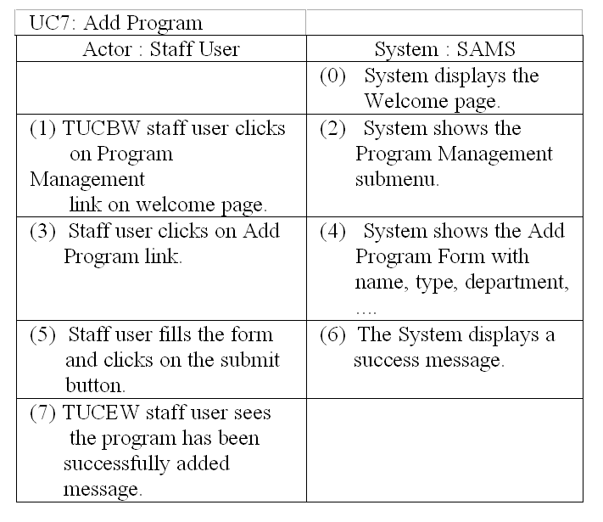
Usefulness of Domain Model
Application
student_name
term
year
language
date_applied
status
Student
*
*
apply for
1..*
Program
name
type
department
institution
subject
region
country
language
term
with
name, type, department, ...
Attributes of Program from the domain model is used to specify the input information requested.
*
manage
1..*
Staff
Part of Domain Model
Copyright © The McGraw-Hill Companies, Inc.

Slide 53
Usefulness of Domain Model
UC7. Add Program
Actor: Staff User | System: SAMS
1. TUCBW staff user clicking on Program Management link on Welcome page. | 2. System displays the Program Management menu.
3. Staff user clicks on Add Program link. | 4. System shows the Add Program form.
5. Staff user fills the Add Program form and clicks the Submit button. | 6. System displays an add program successful message.
7. TUCEW staff user seeing the add program successful message.
As a programmer, how do you know what are the fields of the Add Program form (the designer wants)?
Copyright © The McGraw-Hill Companies, Inc.

Slide 54
Usefulness of Domain Model
UC7. Add Program
Actor: Staff User | System: SAMS
1. TUCBW staff user clicking on Program Management link on Welcome page. | 2. System displays the Program Management menu.
3. Staff user clicks on Add Program link. | 4. System shows the Add Program form
5. Staff user fills the Add Program form and clicks the Submit button. | 6. System displays an add program successful message.
7. TUCEW staff user seeing the add program successful message.
Application
student_name
term
year
language
date_applied
status
Student
*
*
apply for
1..*
Program
name
type
department
institution
subject
region
country
language
term
with name, type, ...
Attributes of the Program class in the domain model specify the fields of the Add Program form.
*
manage
1..*
Staff
Part of Domain Model
Copyright © The McGraw-Hill Companies, Inc.

Slide 55
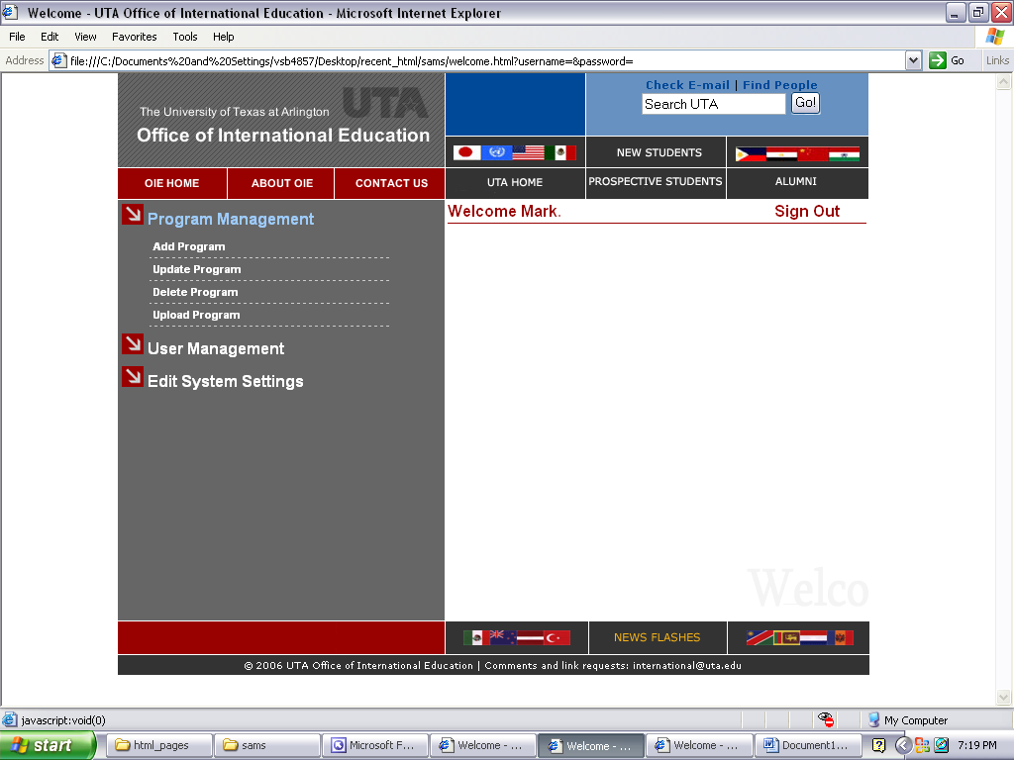
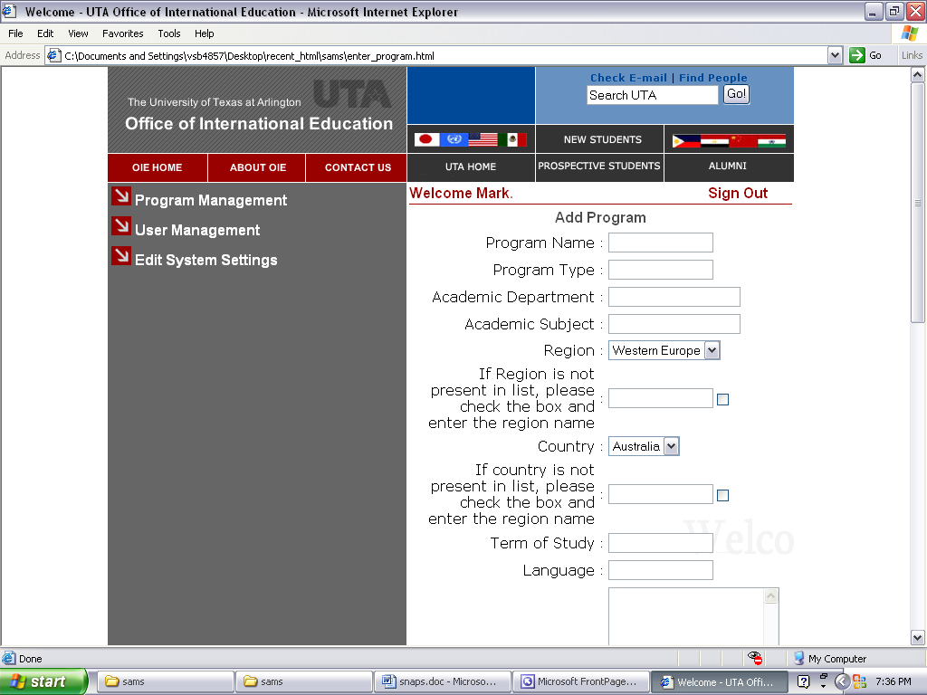
Showing UI Prototypes w/
Expanded Use Case
Actor : Staff User
System : SAMS
(1) TUCBW staff member clicks on Program Management link on welcome page.
(2) System shows the submenu consisting of various operations that a staff user can do under Program Management.
(3) Staff member clicks on Add Program link.
(4) System shows the Add Program Form
(5) User fills the form and clicks on submit button.
(6) The System updates the database with the new program details and displays a success message.
(7) TUCEW staff member is shown a message that the program has been successfully added.
Copyright © The McGraw-Hill Companies, Inc.

Slide 56
Guidelines for Expanded Use Case
The guidelines for high-level use cases are applicable to expanded use cases (because the latter is a refinement of the former).
Each expanded use case should specify a user interface that a novice actor can easily begin
  example: “0) System displays the homepage.”
Expanded use cases may show prototypes of the user interfaces
  for soliciting feedback from the customer/users,
  to inform the programmer what the UI should look like
Copyright © The McGraw-Hill Companies, Inc.

Slide 57
Guidelines for Expanded Use Case
Expanded use cases should always end with the actor and indicating that the system has accomplished the task properly.
Expanded use cases should specify typical actor-system interaction behavior, leave erroneous and exception cases to coding.
Expanded use cases should not specify background processing, which will be dealt with during object interaction modeling.
Copyright © The McGraw-Hill Companies, Inc.

Slide 58
Guidelines for Expanded Use Case
Expanded use case specification may specify pre- and post-conditions but these are not recommended for the following reasons:
  They are not practically useful for software development.
  Several agile principles suggest not showing them:
    Keep it simple and stupid
    Barely enough modeling
    Value working software over comprehensive documentation
Copyright © The McGraw-Hill Companies, Inc.

Slide 59
Use Case Review Checklist
      Are there a use case ID and a use case name for each expanded use case? Do they match with the use case ID and name in the requirement-use case traceability matrix and the corresponding high-level use case?
      Are actors and systems correctly identified and specified, and match with the their counterparts in high-level use cases?
      Does the expanded use case specify the initial system display in step 0?
      Are the TUCBW and TUCEW clauses matched with their counterparts in the high-level use case?
      Does each use case begin and end with the actor on the left column?
      Are there blank entries between the TUCBW and TUCEW clauses?
      Does each expanded use case correctly and adequately specify the actor-system interaction to carry out the business process?
      Do the left-column steps clearly and correctly specify the actor input and actor actions such as clicking the OK button?
      Do the right-column steps clearly and correctly specify the system responses to the actor?
Copyright © The McGraw-Hill Companies, Inc.

Slide 60
Class Exercises
Ex 1. What are the use cases for the Vending Machine?
Ex 2. Banking system.
  State two requirements for a banking system.
  Derive use cases from the requirements.
Ex 3. Your team project.
  State two requirements for your team project.
  Derive use cases from these requirements.
Copyright © The McGraw-Hill Companies, Inc.

